Slide 1



Slide 2

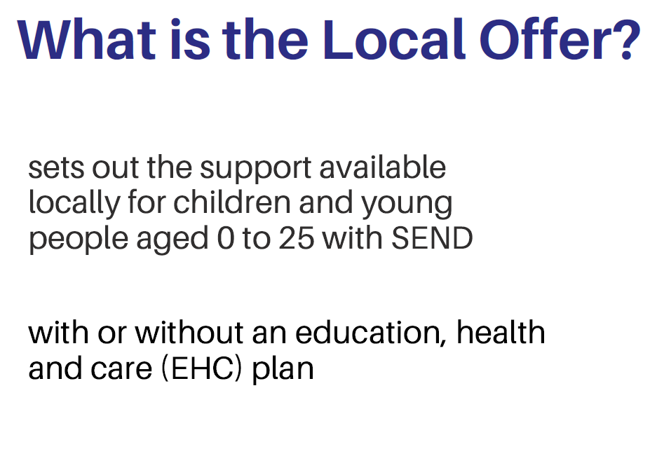

Slide 3
New directory and website process:
User research and testing
In-depth interviews with families and young people
Content re-written to meet best practice and digital accessibility regulations
Following user journeys
‘minimum viable product’

Slide 4
The new public website and directory is for families and was built using feedback and digital best practice to make the information easier to find and understand.
Getting started with SEND
Education and SEND (including the list of EHCCos)
Money and benefits
Health and SEND
Social care
Childcare and early years
Preparing for adulthood
Things to do
Disabled children register
www.familyinfo.buckinghamshire.gov.uk/send

Slide 5
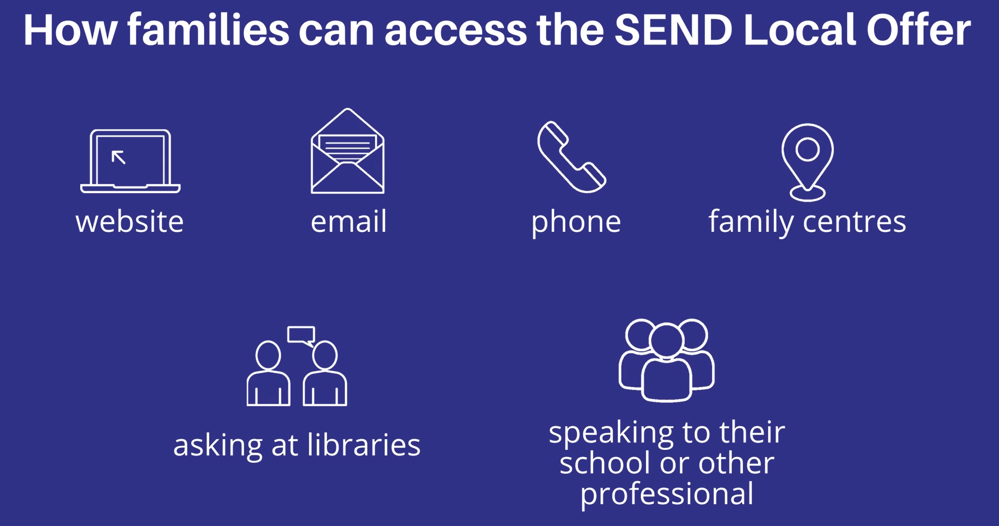

Slide 6
Schoolsweb contains information for professionals, including:
- iSEND area hub information, protocols, advice sessions, network meetings
- SEN Support and the graduated approach
- EHCP information, assessment and letter templates
- Local area SEND improvement information
- Therapies and nurture groups
- Health services
- Funding information
https://schoolsweb.buckscc.gov.uk/send-and-inclusion/

Slide 7
Your role with the SEND Local Offer
Use the SEND Local Offer to find the information you need
Signpost families to the website and directory as a source of information
Promote the SEND Local Offer to families through your available channels (school website, social media)
Champion the SEND Local Offer to other professionals
Encourage families to sign up to the Disabled Children Register
Provide feedback using the form on the website – what do you like, what is missing - what are the most frequently asked questions you receive that aren’t answered on the website?

Slide 8
SEND Local Offer overview video for professionals:
(5 mins 43)
https://youtu.be/xJ0qJeqKYHY

Slide 9
Any questions?

